Slide 1
Lesson 5 update-danger
A
Take 2 laptops back to your seat
Log into WeScheme USING YOUR OWN EMAIL ACCOUNT
Take out Question 3 cookie-profit
B
Take 2 update-danger worksheets
Log into WeScheme USING YOUR OWN EMAIL ACCOUNT
Take out Question 3 cookie-profit
Get the link to your new game file from your email.

Slide 2
Homework due Monday, November 25
Find game images for your game and put them into your game file.

Slide 3
(0,480)
(640,480)
D
(500,300)
480
P
T
(200,240)
(550,140)
(0,0)
640
(640,0)
Notes:
What are the coordinates of the corners?
Coordinates appear clockwise from origin on click
What is the Danger's x-coordinate? Its y-coordinate?
If it is moving to the left, what is changing: the x or y coordinate? Collect data: one finger for x, two for y.
Suppose it moved to the right by 50 pixels. What are the new coordinates? (550,300)
I want my danger to always move left by 50 pixels, each time the screen is redrawn, so that it goes from (550, 300) to (500,300) to (450, 300), etc.
What if it starts at (100, 100)? Where will go next? What if it’s at (400, 600)? What if it’s off the screen, at (650, 50)? (Answer: (50, 100), (350, 600), (600,50))

Slide 4
What is the domain of update-danger?
Number
String Number
String
Image
Number Number
Notes:
Make wrong options fade out over time, then move on. At fade out add self-reflection questions not overtly addressed in the lecture.

Slide 5
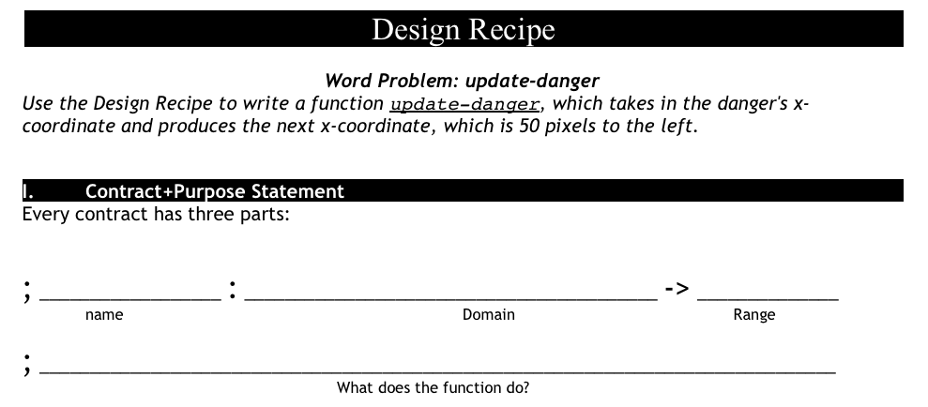
update-danger
what is the name of the function?
what are the inputs?
what are the outputs?

Slide 6
how to write examples for update-danger
Current x-coordinate | Racket Code | Next x-coordinate
50
75
30
(- 50 50)
0
(- 75 50)
25
(- 30 50)
-20
Notes:
Animation : Racket Code -> Next x-coordinate

Slide 7
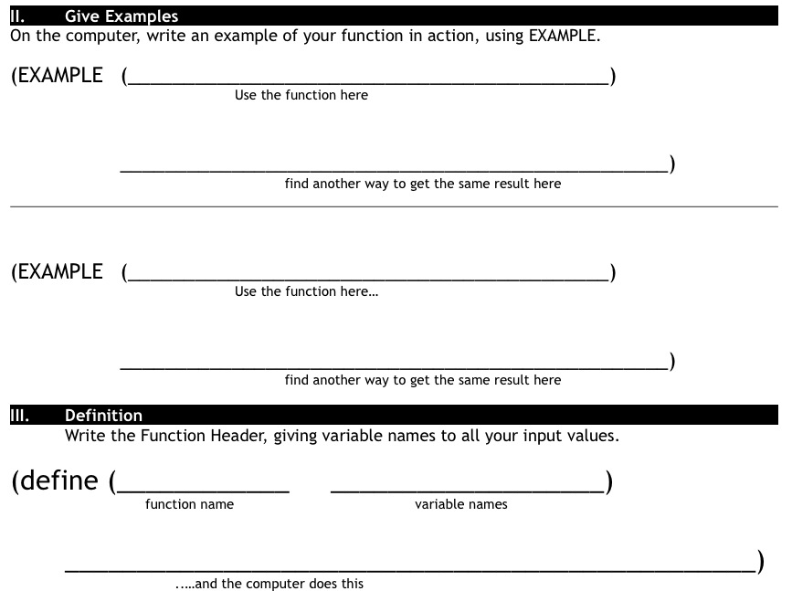
Finish the design recipe with two examples and a definition
Don't forget to circle your examples!

Slide 8
Complete the Design Recipe for update-target
paper first then type
circle examples
ask questions
use your time well

Slide 9
Now you have a 90, don't just satisfy the requirements. Impress me.
Here are some suggestions:
Can you make your danger move slower? faster?
Can you make your target the move other way?
(just try, you can do it)
The promotion goes to the person who goes above and beyond.

